Slide 1




Psychopathology
Session 4

Slide 2



Mid Semester Check-in
What’s Going Well?
What’s Not Going Well?
Other Thoughts, Comments, Questions?

Slide 3

Final Exam
Vignette Provided​
Clear diagnosis possible​
You must:​
Provide accurate DSM Diagnosis including all coding ​
Include Relevant Specifiers​
Provide a clear description of how symptoms meet diagnostic criteria​
Include a discussion of all diagnostic criteria​
Provide a thorough (but not exhaustive) differential diagnosis​
Give specific rational for why you are ruling out​
Include all steps of differential diagnosis​

Slide 4
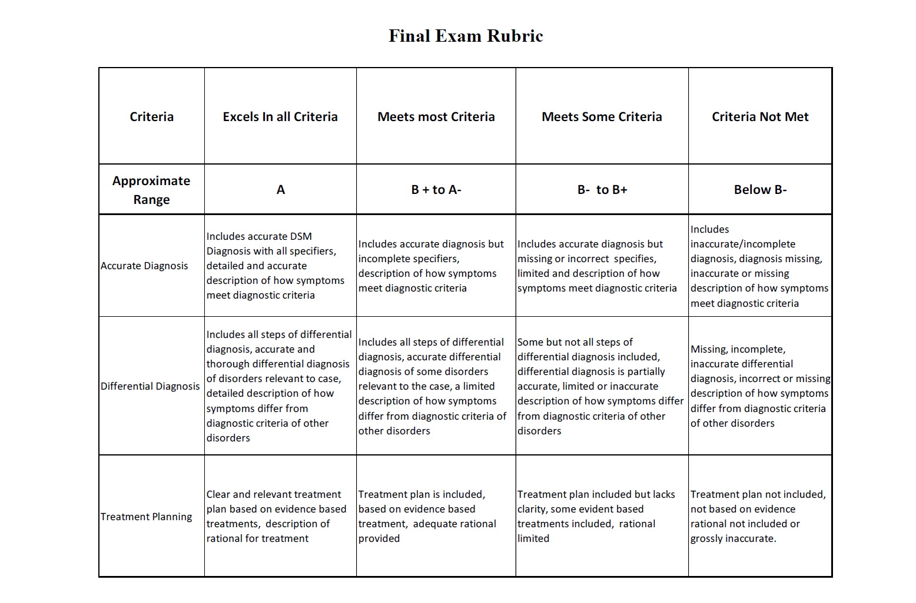

Slide 5

Follow Up From Last Class
How is Clinical Interviewing Different that therapy?
What information do we follow?
Discussion about Experience with Clinical Interviewing from last class
Other Questions?

Slide 6
Trauma and Stress Related Disorders
Exposure to trauma and stress
Includes
Reactive attachment disorder,
Disinhibited social engagement disorder,
PTSD
Acute stress and adjustment disorders
APA, 2022

Slide 7
Reactive Attachment Disorder
Difficulty with Primary Attachment
Limited or no clear connection with caregiver
Does not seek or respond to care when distressed
Muted social engagement
Must have experienced neglect
Typically before age 5

Slide 8
Adjustment Disorders
Emotional or behavior response to a known stressor
One or multiple stressor event(s)
Symptoms experienced within 3 months of an event or stressor(s)
Significant life events, occupational, interpersonal, grief
Responses- Depression, anxiety behavioral
Mixed presentations
APA, 2022

Slide 9
Acute Stress
Distress related to trauma or stress that last 3 days to 1 Month
War, sexual assault, injury,
Real or perceived threat
Symptoms include anxiety, re-experiencing of events, dissociation, emotional instability and reactivity
Must experience symptoms last at least 3 days to 1 month
Different categories of symptoms-Intrusion, negative mood, dissociation, avoidance, and arousal
Nine or more symptoms across all categories
APA, 2022

Slide 10
PTSD
Negative moods and arousal states related to traumatic events(s)
Symptoms and experiences criteria similar to acute stress but some criteria different
Specific number of symptoms in each category differ
Duration of symptoms more that 1 month
Specific criteria for children under 6 years of age
APA, 2022

Slide 11
Dissociative Identity Disorder (DID)
Must include 2 or more distinct personality states
Often identified by gaps in time and awareness of events
Possession vs. Non-possessive forms
Perception of outside control the distinction
Must NOT be attributed to a culturally and spiritually approved practice.

Slide 12
Dissociative Disorders
Disruption and Discontinuity of normal integration
Consciousness, emotions, perception, identity
Includes amnesia, depersonalization and derealization
Often related to trauma
Can include an awareness of the shift in personality/reality sometimes not
APA, 2013

Slide 13
Dissociative Amnesia
Lack of recall of autobiographical information that is not associated with “normal” forgetfulness
Localized- forgetting about a period of time- can be broad
Selective- forgetting about some events and not others
Generalized- Loss of full memory, identity
Need to include specifier of With or Without Fugue
APA, 2022

Slide 14
Depersonalization/Derealization
Depersonalization- Out of body, observer of self
Derealization- Dream like, unreal, not connected to the reality of surroundings.
Must be persistent and recurrent
Everyone has dissociative moments/times
APA, 2022

Slide 15
Vignettes
Break into pairs or groups of three.
Take turns reading vignettes and working through the diagnostic Process.
Client- Roleplay vignette and answers clarifying questions
Clinician- Listens, makes notes, practices clinical interviewing skills, formulates diagnosis.

Slide 16

Differential Diagnosis
Systematic and Step by Step
Do symptoms meet criteria, are the symptoms what we think they are, are they a result of medical or physical issues
First, 2014

Slide 17

Differential Diagnosis-Step 1
Step 1- Rule out Malingering and Factitious Disorder
Malingering- Must have clear goal
Benefit or gain of some kind
Factious disorder
Falsification of symptoms
Lie, mimic, create symptoms
No obvious advantage or benefit
First, 2014

Slide 18
Assessing Factious Disorder and Malingering
How do we evaluate and determine malingering?
What might be some signs a client is malingering?
What are some questions we might ask?
First, 2014

Slide 19
Differential Diagnosis-Step 2
Step 2- Rule out substance related causes
Many if not most symptoms of mental health disorders can be described by substance use, abuse, and withdrawal (Bennett, Peer, Gjonbalaj-Marovic, 2014)
Presence of substance use/abuse hinders diagnosis
Etiology-substance or mental health disorder
Masks, changes, expresses symptoms differently
First, 2014

Slide 20
Differential Diagnosis-Step 2
How to rule out?
Screen for all types of substances-recreational, medication, environmental
Abstinence is required but not always possible
Ask if symptoms were present prior to substance use
Evaluate time, dose, substance type
Do these equate to expressed symptoms
Consider self-medication
First, 2014

Slide 21
Differential Diagnosis-Step 3
Step 3-Rule out General medical condition.
Important but difficult to determine
Symptoms from medical conditions interact with, cause, change psychiatric experience
We are not medical professionals- refer to verify or rule out
We need to have a general understanding of the relationship
First, 2014

Slide 22
Differential Diagnosis-Step 3
Ruling out
Determine which came first- medical or psychiatric
Evaluate for atypical expression of symptoms
If medical etiology determined we diagnose- due to general medical condition
What questions might we ask to rule out medical causes?
First, 2014

Slide 23
Differential diagnosis-Step 4
Step 4- Determine primary disorder
Which category is the best fit
Does the client meet FULL criteria
Proceed to differential diagnosis for that disorder
Use the decision tables and trees & DSM
First, 2014

Slide 24
Differential Diagnosis- Step 5
Step 5- Adjustment disorder, specified, unspecified
Are there stressors that may be cause?
Loss, change, work, relationships
Specified Other
Unspecified Other
First, 2014

Slide 25
Differential Diagnosis- Step 6
Step 6- Establish the Boundary with No mental disorder
Everyone experiences symptoms
Not every experience requires a diagnosis
Clinical significance
Does seeking treatment = clinical significance
First, 2014

Slide 26
Putting the Process together
Intake Paperwork, Clinical Interview, Steps of Differential Diagnosis
The Steps of Differential Diagnosis Inform the What and Why
The Clinical Interview and Intake Process are the How

Slide 27
Practice…
Break into table groups
Use the vignettes provided to practice walking through the steps of differential diagnosis for the final exam process
Focus on identifying key features and symptoms that meet diagnostic criteria
Focus on the process of confirming and ruling out by supporting your diagnosis with facts from the vignette
Be sure to address all steps- 1- 6

Slide 28
Consider this scenario and respond the questions following:
You have been working with a male client who is 22 years of age. His primary focus in therapy has been adjusting to living on his own after college. He arrives to his session uncharacteristically 10 minutes late. He appears agitated, his speech is pressured and what he is saying does not make sense. When asked what has caused him to be so agitated, he responds is a loud excited voice, “They did this to me!” “They are out to get me!” “You have to help me, you’re the only one I trust!”
He sits down and seems to calm down enough to continue the session. He continues to speak quickly, but more coherently. He tells you he was out with friends last night to celebrate his best friend’s birthday. During the outing he began to feel unsettled and anxious. These feelings have increased throughout the night and into the morning. He reports feeling panicked all day and feels that he is being followed.
Based on your client’s presentation what is your initial diagnosis?
What information do you need to confirm or rule out this diagnosis?
List other possible diagnoses and your rationale for considering them.

Slide 29
Eating Disorders
Pica
Non-nutritious and nonfoods
Non-developmentally appropriate
Rumination Disorder
Regurgitating and rechewing already swallowed food
Avoidant/Restrictive Food Intake
Not eating or restricting types of food
APA, 2022

Slide 30
Eating Disorders
Anorexia Nervosa
Restriction of food intake resulting in inability to maintain minimum healthy weight
Significant fear of gaining weight and distortion in view of body shape
Psychological experiencing include depression, insomnia, anxiety, distractibility and obsessive thinking/behavior
High comorbidly with, dysthymia, depression, social phobia, GAD, and OCD,
Social and interpersonal problems exist outside AN and consideration needed as AN treatment progresses.
Castonguay & Oltmanns, 2013

Slide 31
Eating Disorders
Bulimia Nervosa
Eating more that typical amounts of food in short period of time
Inability to control eating
Usually eat food they otherwise avoid
Compensatory Behaviors
Vomiting, laxatives
Individuals maintain a typical weight
Binge-eating Disorder
Similar eating behaviors to BN, but not compensatory behaviors
APA, 2022

Slide 32
Group work
Break into groups of (total of 4 groups)
Create a summary of the disorder assigned to your group
Bullet point key features and diagnostic criteria—Create PowerPoint
Create a short vignette that includes relevant symptoms
Role Play Clinical Interview and Presentation
Select a client and a Psychologist
Start the diagnostic interview and the class will jump in and conduct differential diagnosis
Presentation of Diagnostic Criteria
Total Presentation about 15 mins

